Slide 1
Hospital general information
CAPSTONE PROJECT
Presented By:
Vinoth kumar C
9513- Jayaraj Annapackiam CSI College Of Engineering
B.E Mechanical Engineering

Slide 2
OUTLINE
Problem Statement
Proposed System/Solution
System Development Approach
Algorithm & Deployment
Result
Conclusion
Future Scope
References

Slide 3
Problem Statement
Inefficient patient management and outdated administrative processes are hindering the effectiveness and efficiency of hospital operations. Patients often experience long wait times, scheduling difficulties, and inconsistent communication, leading to decreased satisfaction levels. Additionally, manual record-keeping and limited data accessibility are impeding healthcare professionals' ability to make timely and informed decisions. There is a pressing need to implement a comprehensive hospital management system that streamlines patient care, optimizes resource allocation, improves communication, and enhances overall operational efficiency. The system should integrate patient registration, appointment scheduling, electronic health records (EHR), billing, inventory management, and communication tools to facilitate seamless collaboration among healthcare providers and deliver high-quality patient-centric care.

Slide 4
Proposed Solution
Patient Registration and Management:
Implement a user-friendly interface for patient registration, capturing essential information such as personal details, medical history, insurance information, and emergency contacts.
Develop a centralized patient database for easy access and management of patient records.
Appointment Scheduling:
Create an online appointment scheduling system for patients to book appointments with healthcare providers based on availability.
Allow for automated appointment reminders via email or SMS to reduce no-show rates.
Electronic Health Records (EHR):
Integrate an EHR system to digitize and store patient medical records, including diagnosis, treatment plans, medications, lab results, and imaging reports.
Ensure data security and privacy compliance (e.g., HIPAA) with robust access controls and encryption measures.
Communication and Collaboration Tools:
Integrate communication tools such as secure messaging, video conferencing, and telemedicine capabilities for remote consultations.
Facilitate seamless collaboration among healthcare teams, enabling real-time communication and information sharing.

Slide 5
System Approach
Requirement Analysis:
Gather requirements from stakeholders including hospital administrators, healthcare professionals, and IT teams.
Identify key modules such as patient registration, appointment scheduling, electronic health records (EHR), billing, inventory management, and reporting.
Patient Management:
Patient Registration: Develop a module for new patient registration, capturing personal details, medical history, insurance information, and emergency contacts.
Appointment Scheduling: Implement a calendar-based scheduling system for patients to book appointments with healthcare providers based on availability.
Electronic Health Records (EHR):
Implement EHR functionality for healthcare professionals to create, update, and access patient records, including diagnosis, treatment plans, medications, lab results, and imaging reports.
Ensure data security and compliance with healthcare regulations for handling sensitive patient information.
Billing and Finance Management:
Develop a billing module to generate invoices, process payments, manage insurance claims, and track financial transactions.
Integrate with payment gateways for online payment processing and billing reconciliation.
Testing and Quality Assurance:
Conduct thorough testing including unit testing, integration testing, functional testing, and user acceptance testing (UAT) to ensure system reliability, functionality, and user satisfaction.

Slide 6
Algorithm & Deployment
Hospital Management System Algorithm Overview:
Patient Registration and Management:
Algorithm:
Collect patient details including personal information, medical history, insurance data, and emergency contacts.
Store patient data securely in the database.
Functionality:
Allow patients to register online or at the hospital.
Manage patient records, update information, and track visits.
Appointment Scheduling:
Algorithm:
Check provider availability based on schedules and specialties.
Assign appointments to available time slots.
Functionality:
Enable patients to schedule appointments online or through a mobile app.
Send appointment reminders to patients and notifications to providers.
Electronic Health Records (EHR):
Algorithm:
Create electronic health records for patients during their visits.
Update records with diagnosis, treatment plans, medications, lab results, and imaging reports.
Functionality:
Provide healthcare providers with access to patient EHRs for real-time data entry and retrieval.
Ensure data privacy and security with role-based access controls.
:

Slide 7
Deployment
Infrastructure:
Choose a reliable and scalable infrastructure provider (e.g., AWS, Azure, Google Cloud) based on performance, security, and compliance requirements.
Set up virtual machines, databases, storage solutions, and networking configurations.
Application Deployment:
Containerization: Use Docker containers for packaging and deploying application components.
Orchestration: Utilize Kubernetes or similar orchestration tools for managing containerized applications at scale.
Database Management:
Choose a database system (e.g., MySQL, PostgreSQL, MongoDB) based on data structure, scalability, and performance needs.
Implement database backups, replication, and disaster recovery measures.
Security:
Secure Communication: Use HTTPS/TLS for secure communication between clients and servers.
Access Control: Implement role-based access controls (RBAC) to restrict data access based on user roles.
Encryption: Encrypt sensitive data at rest and in transit to protect against unauthorized access.

Slide 8
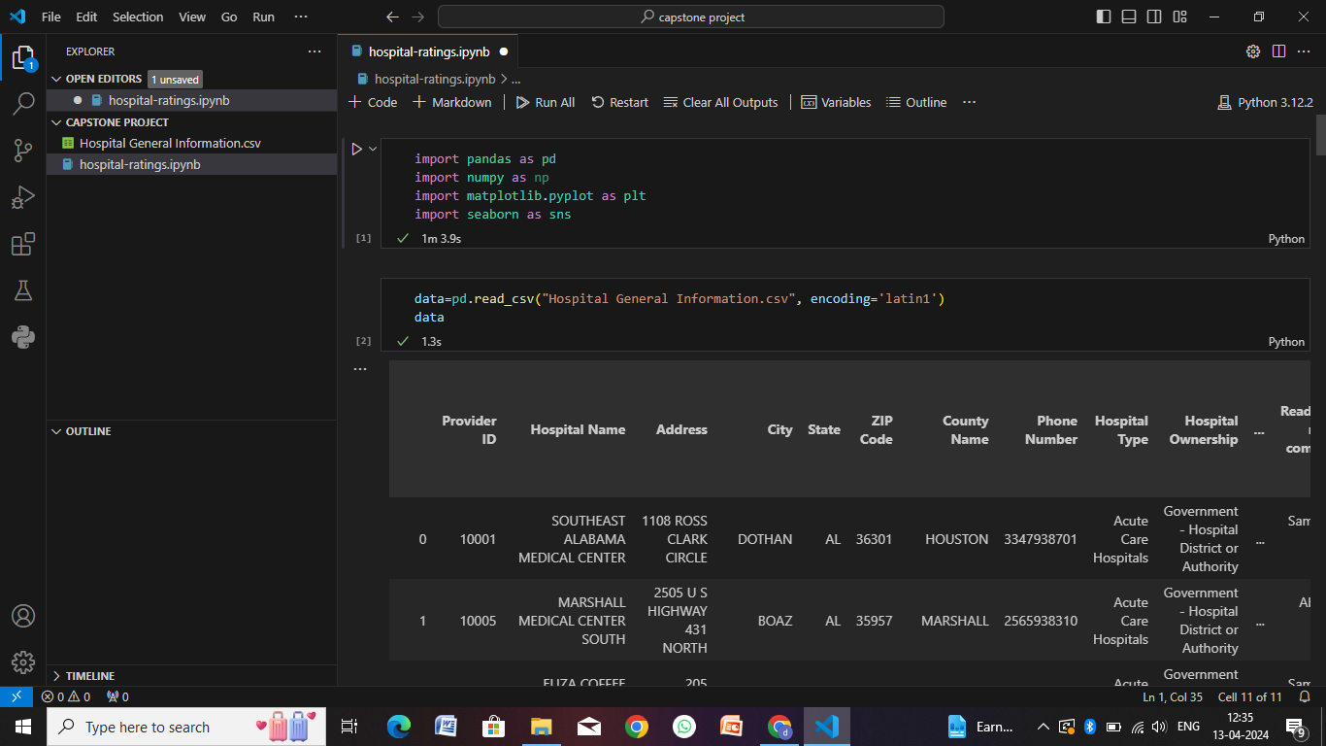
Result

Slide 9
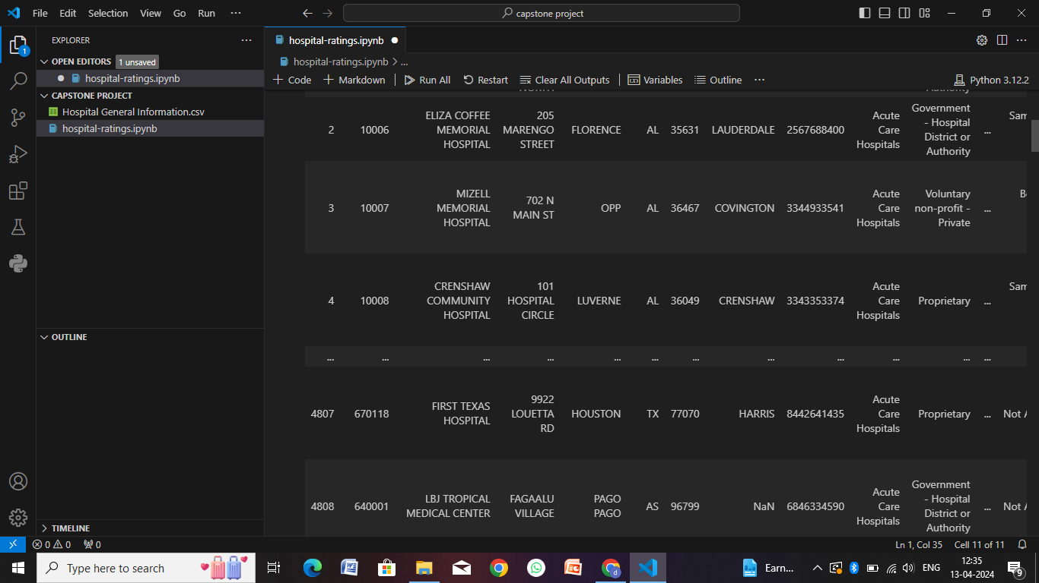

Slide 10
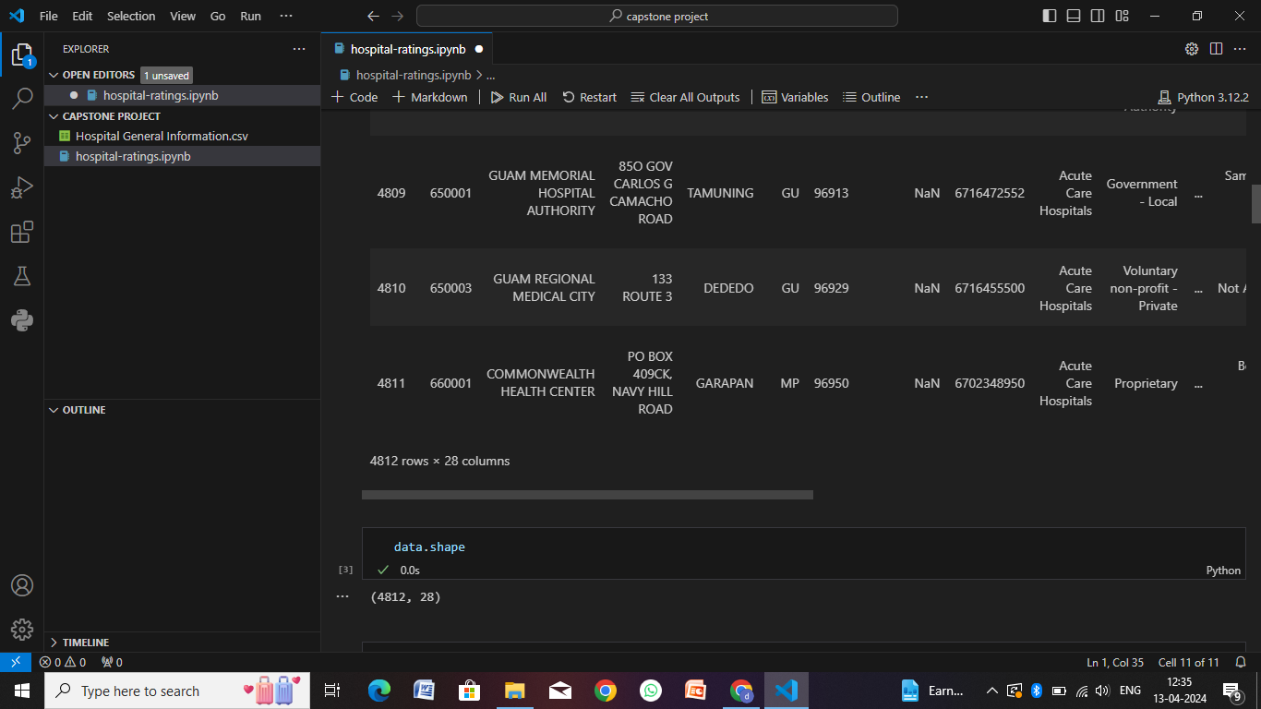

Slide 11
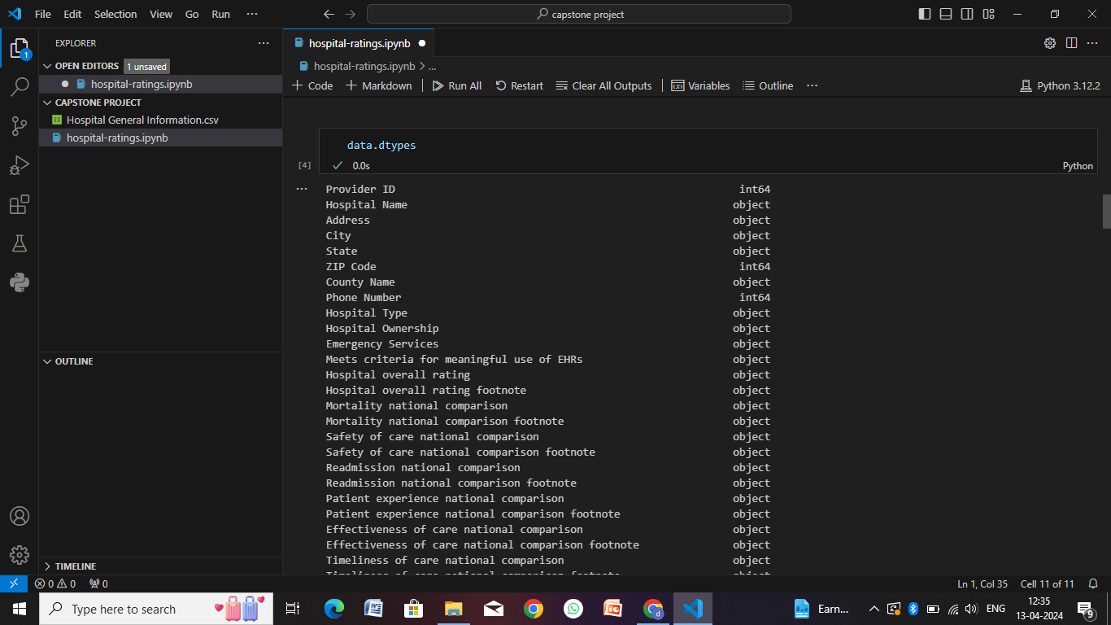

Slide 12
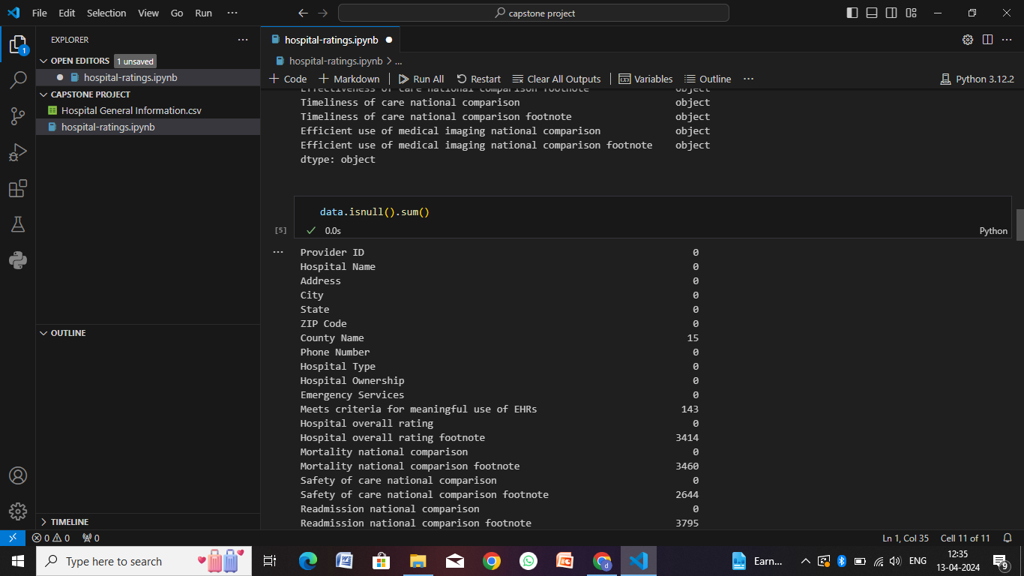

Slide 13
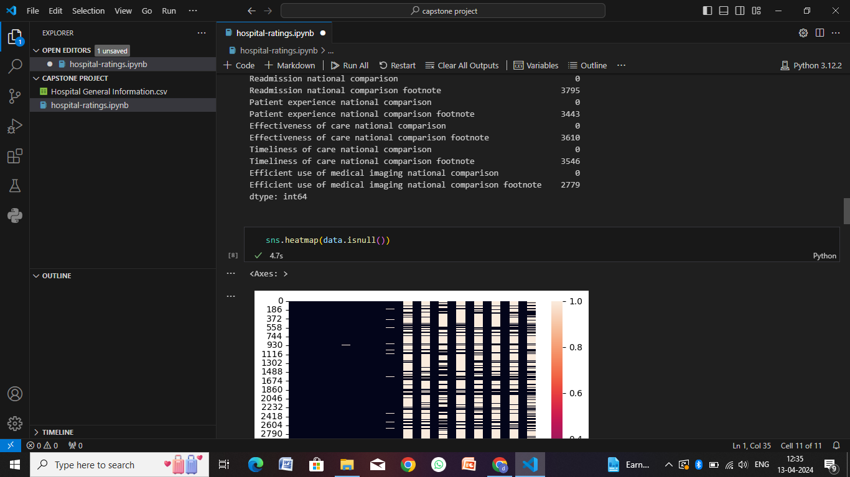

Slide 14


Slide 15
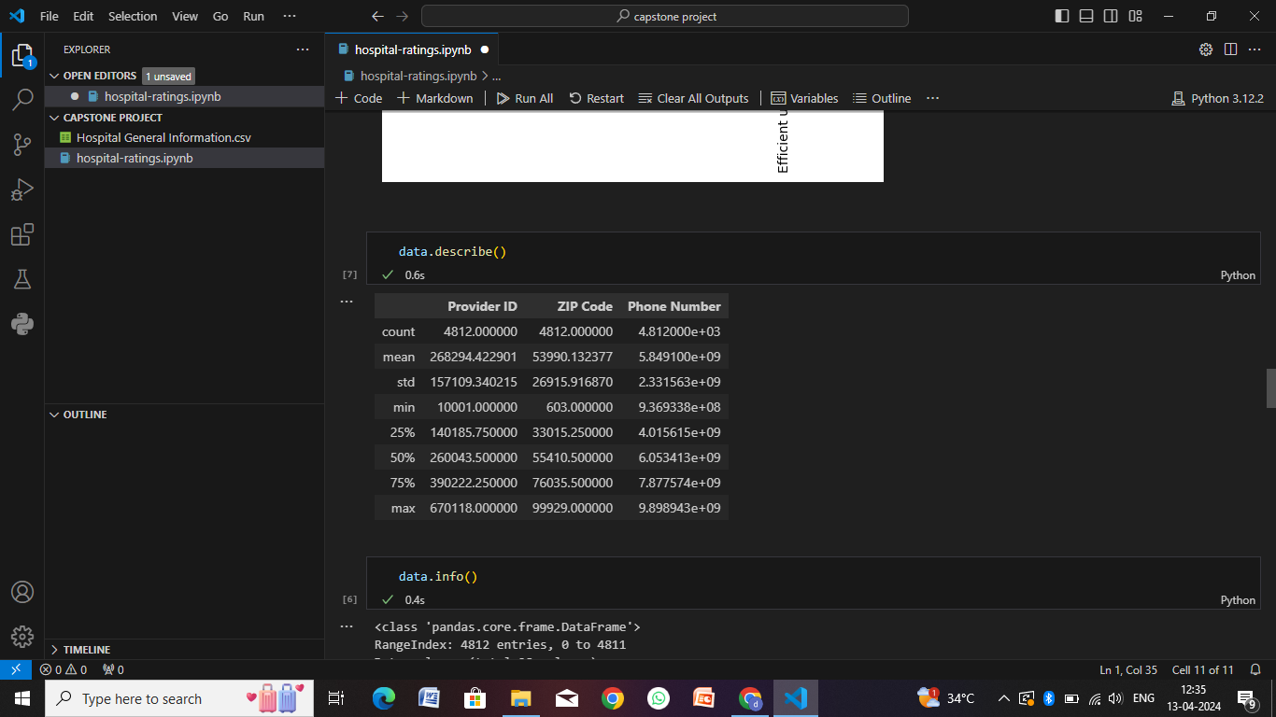

Slide 16
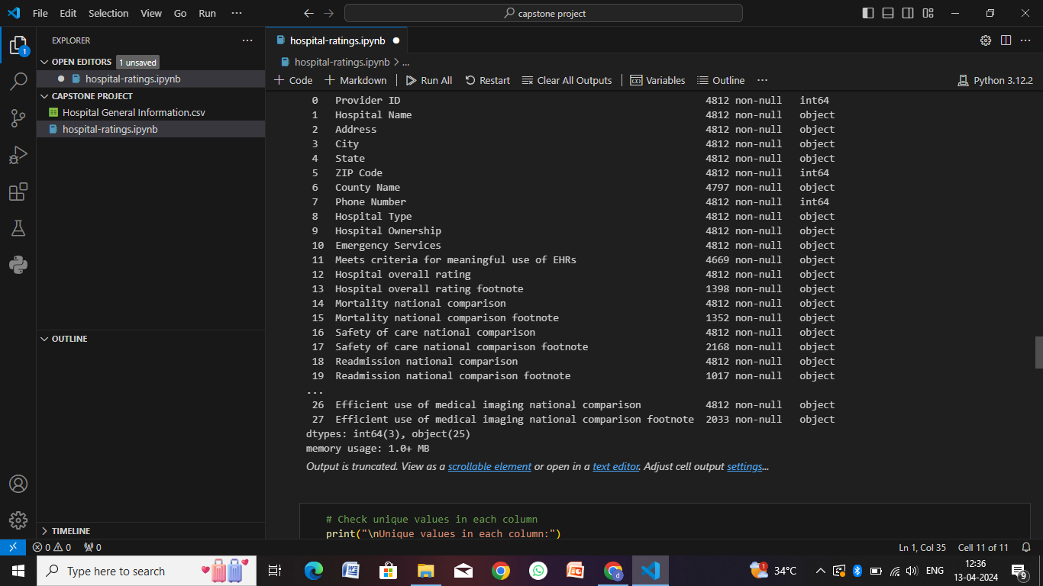

Slide 17
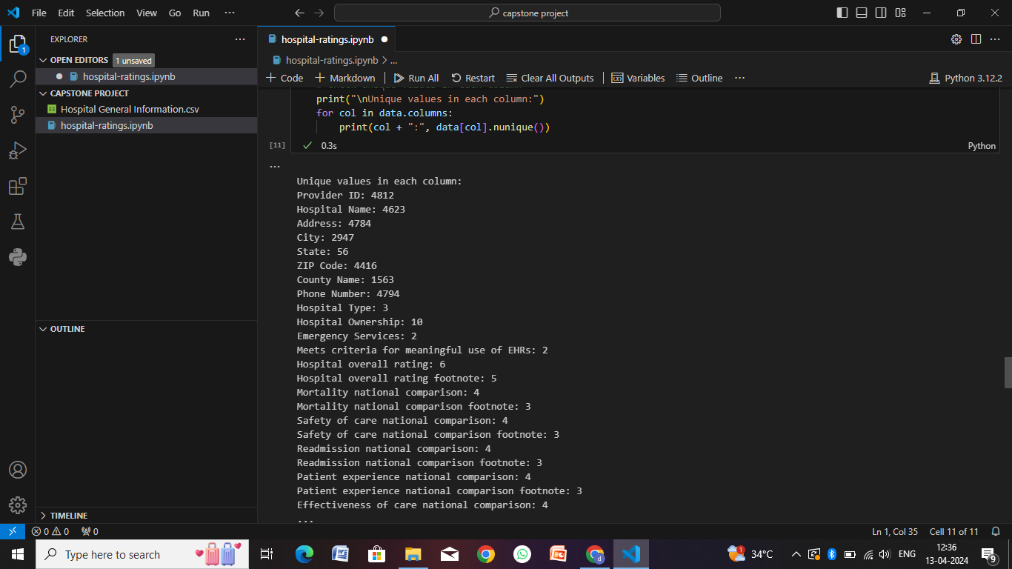

Slide 18
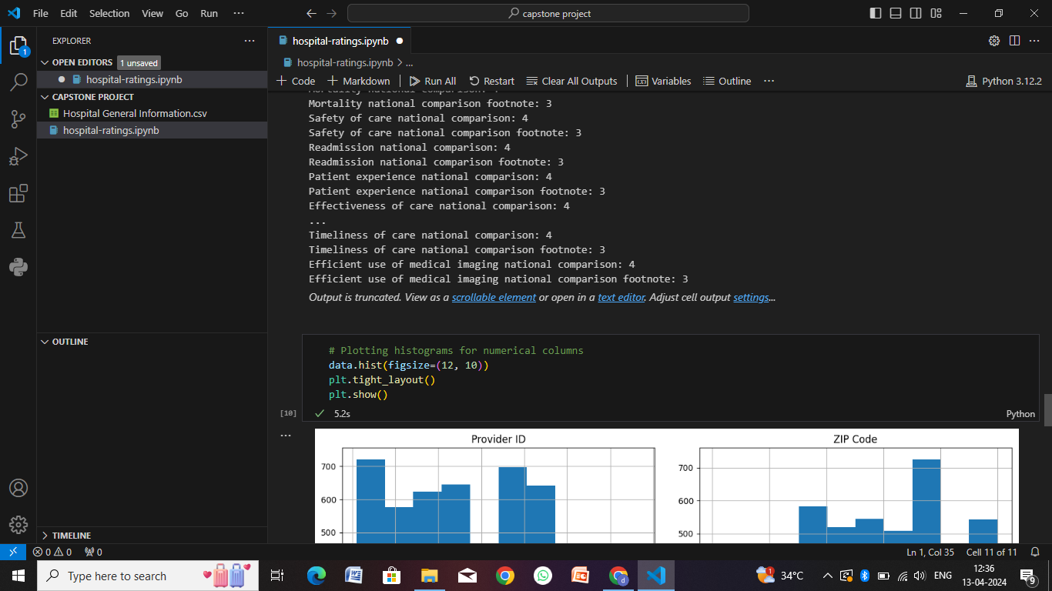

Slide 19
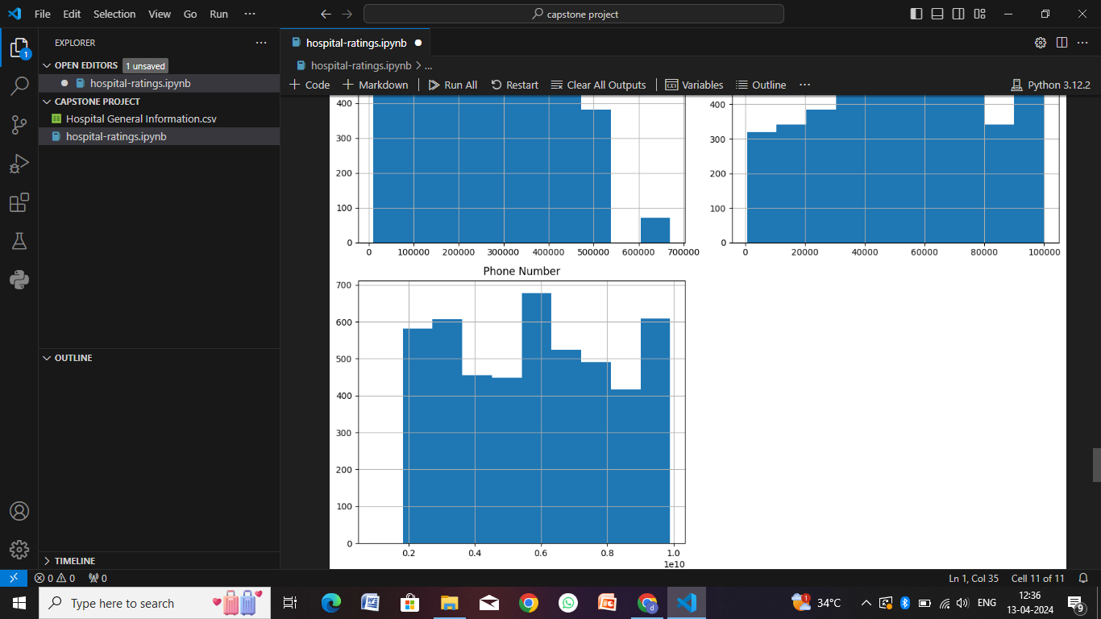

Slide 20
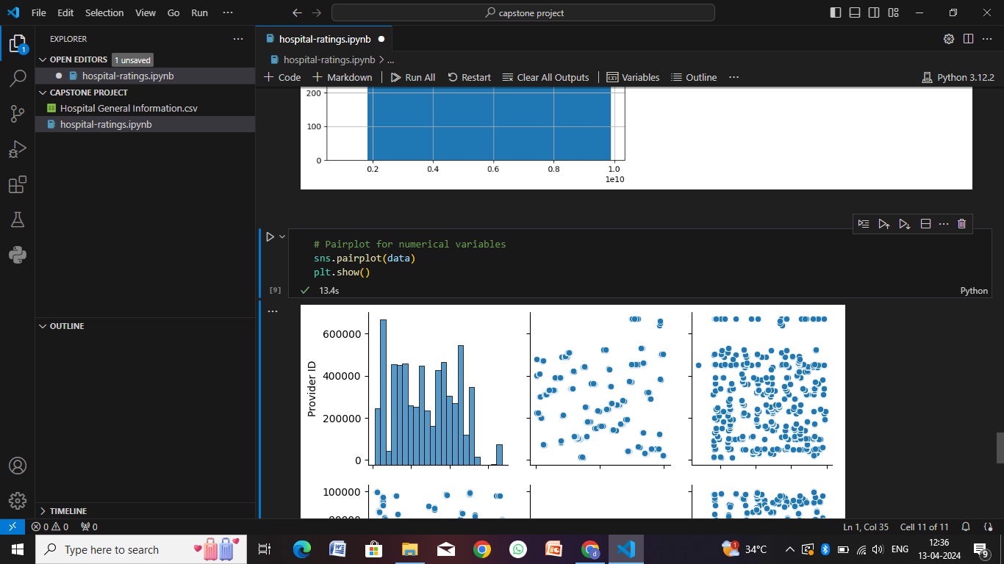

Slide 21
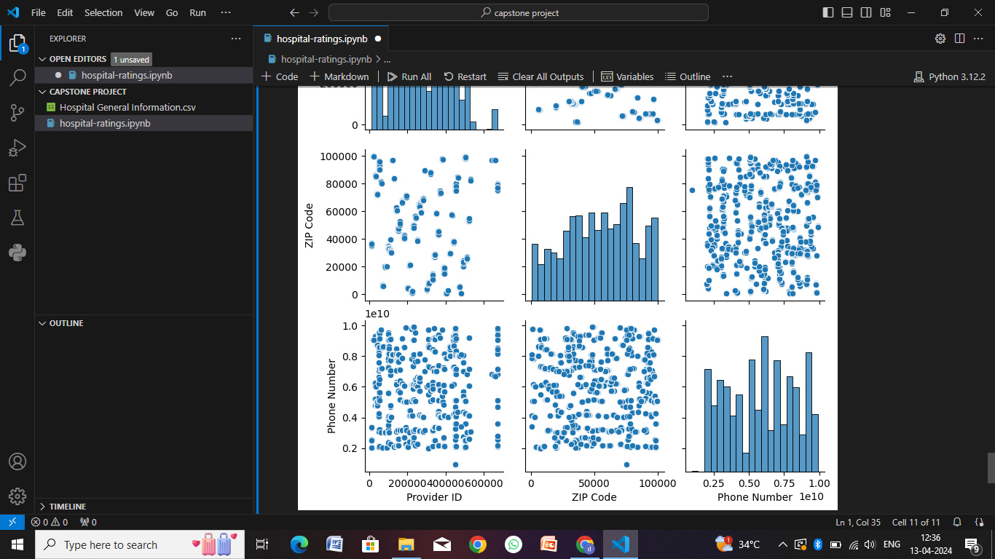

Slide 22
Conclusion
In conclusion, implementing a comprehensive hospital management system (HMS) brings numerous benefits to healthcare institutions, patients, and healthcare professionals. Here are some key points highlighting the significance of an HMS:
Improved Patient Care: An HMS streamlines patient management processes, enhances communication between healthcare providers and patients, and ensures timely access to medical records and treatment plans. This leads to improved patient outcomes and satisfaction.
Efficient Operations: Automation of administrative tasks such as appointment scheduling, billing, inventory management, and reporting results in increased operational efficiency, reduced errors, and cost savings for hospitals.
Data-driven Decision Making: The integration of electronic health records (EHR) and analytics capabilities in an HMS enables healthcare professionals to make informed decisions based on real-time data, patient trends, and performance metrics.
Enhanced Collaboration: With features like secure messaging, telemedicine capabilities, and centralized data access, an HMS promotes collaboration among healthcare teams, specialists, and departments, leading to better-coordinated care and treatment plans.
Patient Engagement and Empowerment: Patient portals, online appointment booking, and access to health information empower patients to take an active role in their healthcare journey, fostering engagement and adherence to treatment plans.
Compliance and Security: An HMS ensures compliance with healthcare regulations (e.g., HIPAA) and implements robust security measures to protect patient data, privacy, and confidentiality.

Slide 23
Future scope
The future of hospital management systems (HMS) holds significant potential for innovation and transformation in the healthcare industry. Here are some key areas of future scope for HMS:
AI and Machine Learning Integration
IoT and Wearable Devices
Telemedicine and Remote Care
Blockchain for Health Data Management
Precision Medicine and Genomics
Virtual Reality (VR) and Augmented Reality (AR)
Population Health Management
Cybersecurity and Data Privacy
Collaborative Care Networks:
Continuous Innovation and Integration.

Slide 24
References
Websites and Online Resources:
Healthcare Information and Management Systems Society (HIMSS) - Offers resources, articles, and insights into healthcare IT, including hospital management systems. Website: https://www.himss.org/
HealthIT.gov - Provides information on healthcare technology, interoperability, electronic health records (EHR), and digital health initiatives. Website: https://www.healthit.gov/
Journals and Publications:
Journal of Hospital Administration (JHA) - Publishes research articles, case studies, and reviews on hospital management, healthcare administration, and healthcare technology. Website: https://www.sciedupress.com/journal/index.php/jha
Journal of Health Informatics in Developing Countries (JHIDC) - Focuses on health informatics, eHealth, and digital health solutions in developing countries, including hospital management systems. Website: http://www.jhidc.org/index.php/jhidc
Conferences and Events:
HIMSS Annual Conference & Exhibition - One of the largest healthcare IT conferences, featuring presentations, workshops, and exhibitions on hospital management systems, electronic health records, and healthcare technology. Website: https://www.himssconference.org/
HealthTech Conference - A conference focused on technology innovations in healthcare, including hospital management systems, digital health, telemedicine, and AI in healthcare. Website: https://healthtechconferences.com/

Slide 25
THANK YOU

